Slide 1
0x205 – Example: Secure Message Delivery
ECED4406 – Computer Security
Dr. Colin O’Flynn
Dalhousie University.

Slide 2
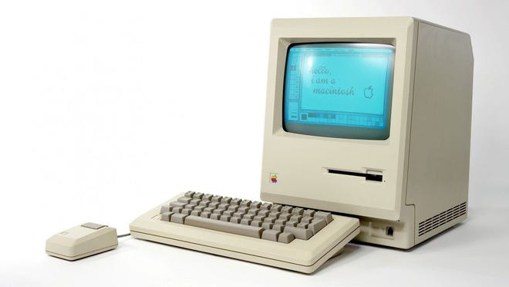
The Setup
You want to email your friend a message, and do it securely.

Slide 3
Make a Message
Hello dear friend.
I hope you find today well.
Your good friend,
-Colin

Slide 4
Step #1: Confidentiality
ENCRYPTION ALGORITHM
Hello dear friend.
I hope you find today well.
Your good friend,
-Colin
98798312kjlkasjdlka09
Lkjawlew90ujlakjdw
lkjadwdw0a9udjoiWDA
kljdwoajd9AJWD)
lkjdoajwd0JDAWD)JWAD
09djaldwoapijdw9

Slide 5
Step #2: Integrity
HASH ALGORITHM
ie, SHA-1
http://www.sha1-online.com/
98798312kjlkasjdlka09
Lkjawlew90ujlakjdw
lkjadwdw0a9udjoiWDA
kljdwoajd9AJWD)
lkjdoajwd0JDAWD)JWAD
09djaldwoapijdw9
d5bbbcd7aa0fdd060f21d501b338f3996787a0f8

Slide 6
Step #3: Authentication
98798312kjlkasjdlka09
Lkjawlew90ujlakjdw
lkjadwdw0a9udjoiWDA
kljdwoajd9AJWD)
lkjdoajwd0JDAWD)JWAD
09djaldwoapijdw9
Digital Signature Operation
89789172891892381927398123
d5bbbcd7aa0fdd060f21d501b338f3996787a0f8

Slide 7
Message Sent to Friend
My friend then:
Performs the hash operation on the message.
Checks the digital signature verifies OK for the hash they calculated.
If anything off – either has different or signature fail, indicates problems!
Decrypts message.
98798312kjlkasjdlka09
Lkjawlew90ujlakjdw
lkjadwdw0a9udjoiWDA
kljdwoajd9AJWD)
lkjdoajwd0JDAWD)JWAD
09djaldwoapijdw9
89789172891892381927398123
+

